Slide 1
Job market analysis(PRDA-04)
Submitted by:
Laxmi Kaddoni
Tools Used: mysql | jupyter Notebook | Power BI

Slide 2
1. Introduction
This project focuses on analyzing job market trends related to Data Science and similar roles. The dataset contains information about job titles, salaries, companies, locations, skills, and educational requirements. The main aim is to help job seekers and employers understand current market demands.
2. Objectives
To analyze state-wise job distribution.
To study salary patterns across locations and roles.
To identify in-demand skills.
To find top hiring companies and industries.
To understand the impact of education on salary.
To provide useful business and career insights.

Slide 3
3. Dataset Description
Source: Online Job Portals
Total Records: 742
Total Features: 42
Important Columns:
  Job Title
  Salary Estimate
  Job Description
  Company Name
  Location
  Industry
  Skills (Python, SQL, AWS, etc.)
  Degree

Slide 4
4. Tools and Technologies
MySQL: Data storage
Python: Data analysis
Pandas and NumPy: Data processing
PowerBI: Data visualization
MS PowerPoint: Presentation
5. Project Workflow
Data Collection
Data Cleaning and Preprocessing
Exploratory Data Analysis
Visualization
Insight Generation
Recommendations

Slide 5
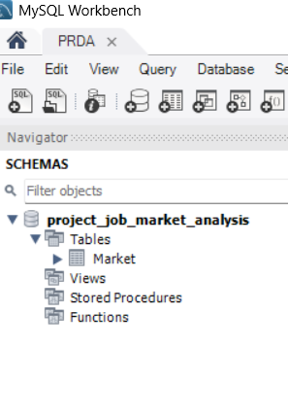
6. DataBase Schema Verification
This screenshot shows the schema view of the MySQL database.
The database named project_job_market_analysis contains the job market dataset.
The table Market stores all job-related information such as job title, salary, company name, location, industry, and required skills.
This step confirms that the dataset is properly organized and ready for further analysis.

Slide 6
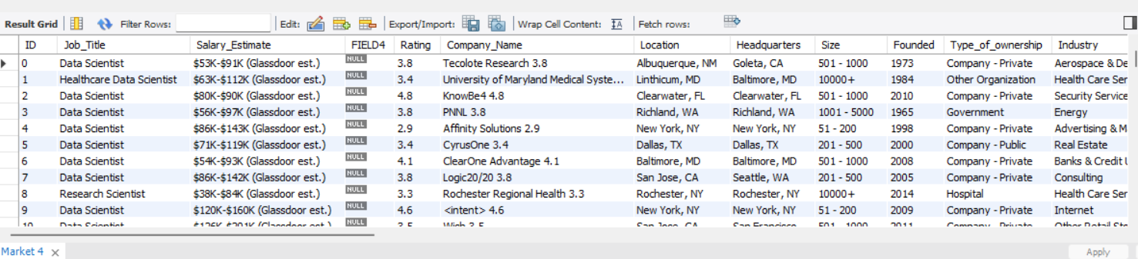
7. Market Table – Sample Data (limit 100)
This screenshot shows the first 100 records from the Market table using the LIMIT clause.
The query was executed to display a sample of the dataset without loading the entire data.
This step was performed to verify that the data was correctly imported into the database.
It also helped in checking the accuracy, consistency, and completeness of the job market data before further analysis.

Slide 7
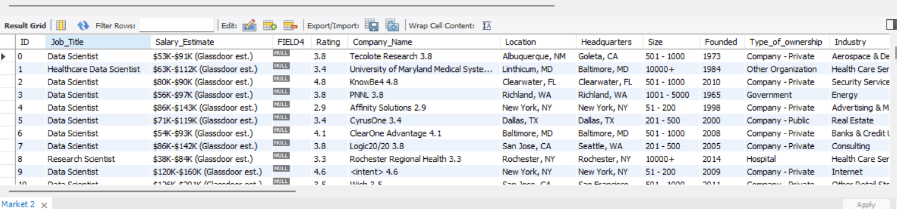
8.Complete Market Table (Full Data)
This screenshot shows the complete view of the Market table containing the job market dataset.
It displays all columns and records stored in the database.
This step confirms that the entire dataset has been successfully imported without any data loss.
The verified dataset is now ready to be fetched into Python for data cleaning, analysis, and visualization.

Slide 8
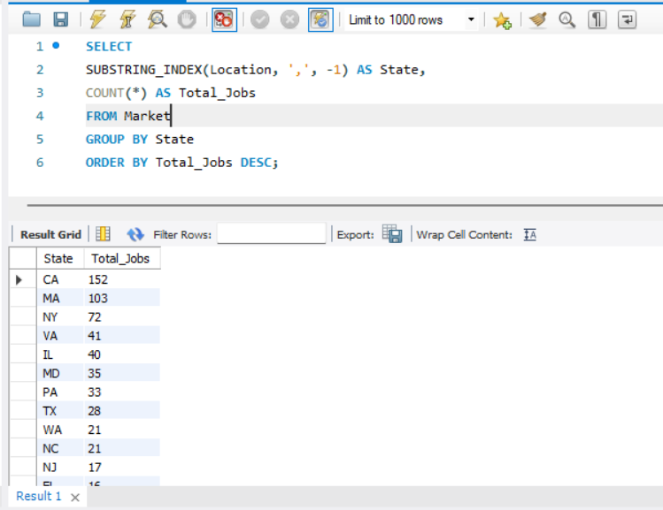
9.State-wise Job Distribution Using SQL Query
This screenshot shows both the SQL query and its corresponding output for analyzing state-wise job distribution.
The query was executed to extract state information from the location column and count the number of job postings in each state.
The GROUP BY and COUNT functions were used to calculate the total number of jobs in every state.
The results were arranged in descending order to identify states with the highest job opportunities.
This analysis revealed that states such as California, Texas, and New York have the maximum number of job postings.

Slide 9
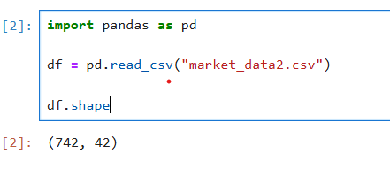
10.Loading Job Market Dataset into Jupyter Notebook
This screenshot shows the process of loading the job market dataset into Jupyter Notebook using the Pandas library.
The data was stored in a DataFrame for further analysis.

Slide 10
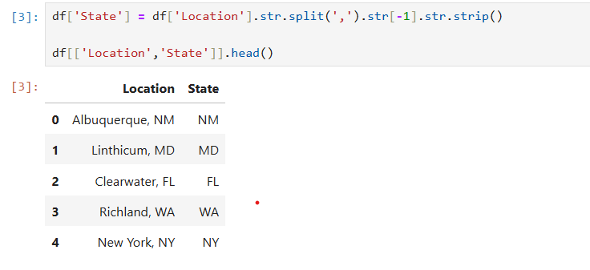
11.Extracting State Information from Location Column
This screenshot shows the extraction of state names from the location column.
A new column named State was created to perform state-wise salary analysis.

Slide 11
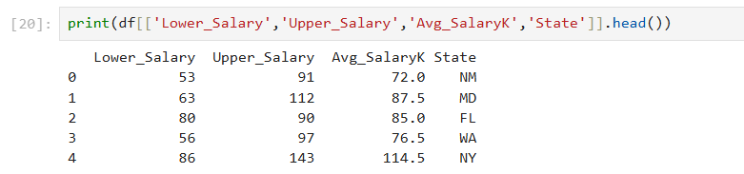
12.Verification of Salary Columns
This step verifies the presence of minimum, maximum, and average salary columns before analysis.

Slide 12
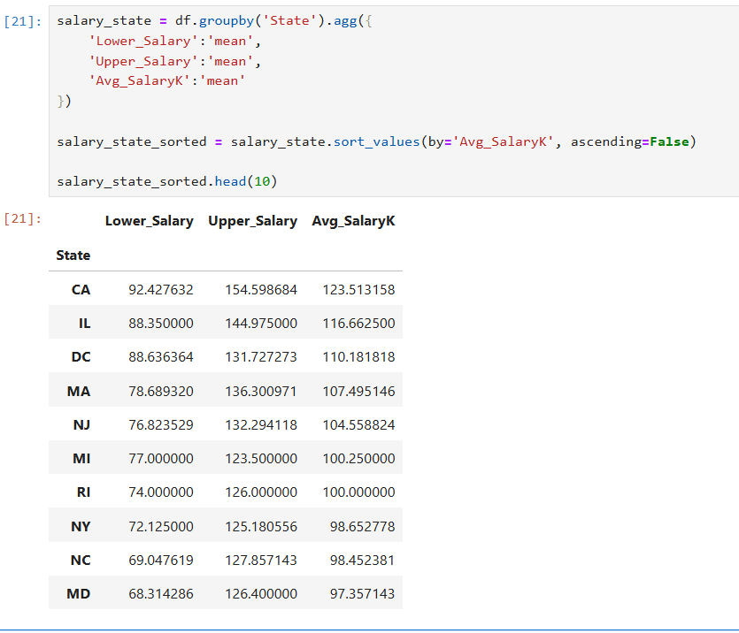
13.State-wise Minimum, Maximum and Average Salary Calculation
The dataset was grouped by state and the mean values of minimum, maximum, and average salaries were calculated using Pandas aggregation.

Slide 13
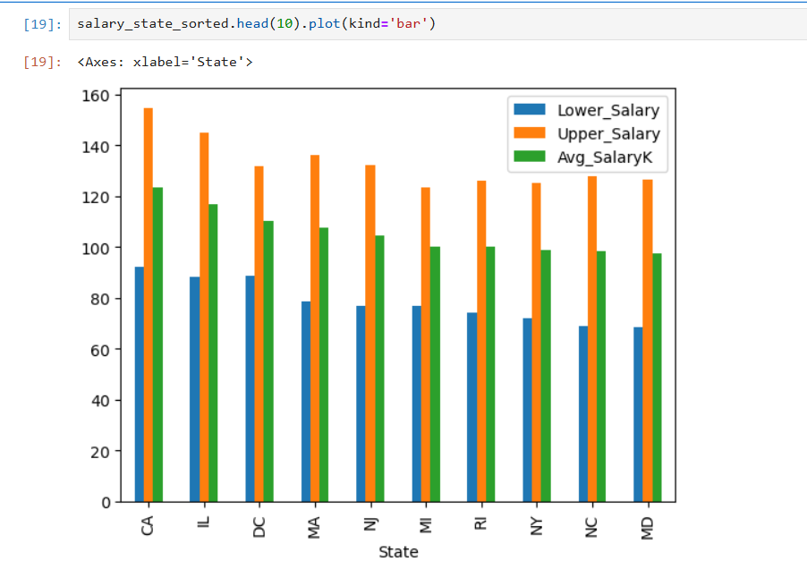
14.Top 10 States – Minimum,Maximum and Average Visualization
This bar chart visualize s tge top 10 states based on average salary,comparing minimum,maximum,and average levels for better understanding of state-wise salary distribution.

Slide 14
15.Insights from State-wise Salary Analysis
Some states offer higher minimum, maximum, and average salaries due to the presence of major IT and analytics companies.
A significant gap is observed between lower and upper salary values in many states, indicating variation based on experience and skills.
States with higher average salaries provide better career growth and professional development opportunities.
Certain states show comparatively lower salary ranges, reflecting limited job demand and fewer high-paying organizations.
States with higher job demand tend to offer better salary packages, showing a direct relationship between demand and compensation.

Slide 15
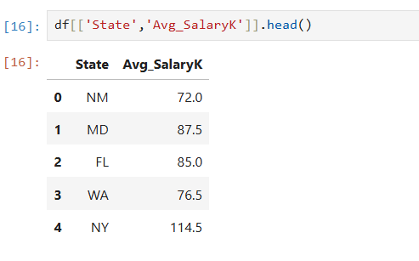
16.Verification of Average Salary Data
This step verifies the presence of state and average salary columns for further analysis.

Slide 16
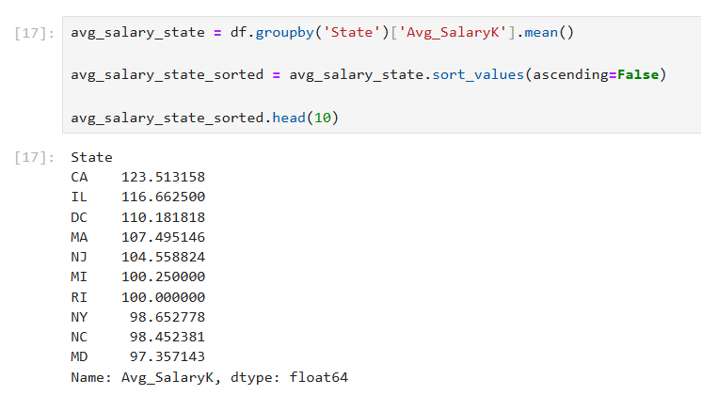
17.State-wise Average Salary Calculation
The dataset was grouped by state and the mean average salary was calculated using Pandas.

Slide 17
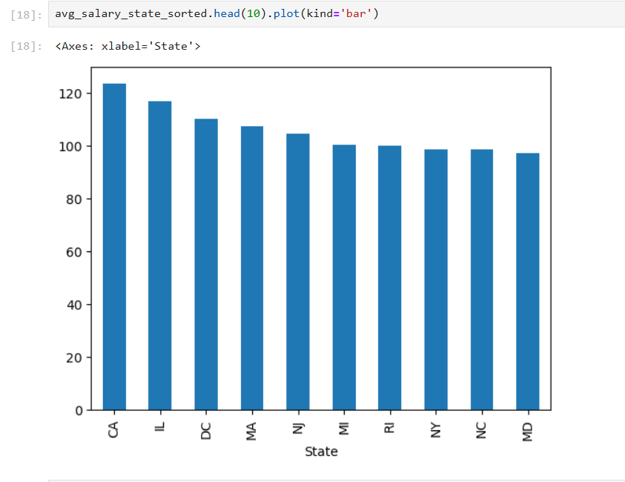
18.Top 10 States by Average Salary
A bar chart was created to visualize states offering the highest average salaries.

Slide 18
19.Insights from State-wise Average Salary Analysis
Some states consistently offer higher average salaries, making them attractive locations for data professionals.
There is a noticeable difference in average salaries among different states, showing regional economic differences.
States with strong technology and analytics ecosystems tend to provide better salary packages.
Higher competition for skilled professionals in certain states leads to increased average salaries.
Geographical location plays a major role in determining salary levels and long-term earning potential.

Slide 19
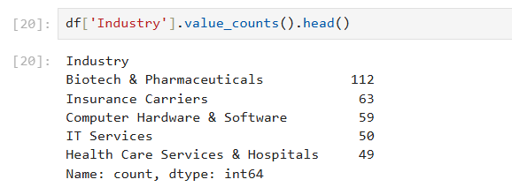
20.Verification of Industry Data
This step verifies the industry column and displays sample counts of job postings.

Slide 20
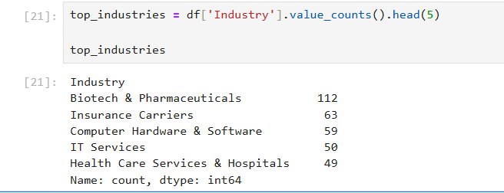
21.Top 5 Industries by Job Openings
This analysis identifies the top five industries with the highest number of data science related job postings.

Slide 21

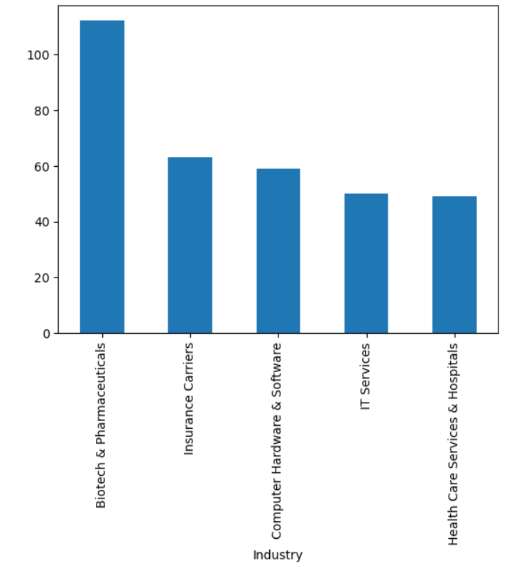
22.Industry-wise Job Distribution
A bar chart was created to visualize the distribution of job postings across major industries.

Slide 22
23.Insights from Industry-wise Job Analysis
The IT and software industry has the highest number of data science job postings, showing strong demand for data professionals.
Analytics and consulting industries actively hire data scientists to support business decision-making.
Industries that rely on big data and artificial intelligence show continuous growth in job opportunities.
Traditional industries have fewer data science job postings compared to modern, technology-driven sectors.
Choosing high-demand industries can provide better job security, salary growth, and learning opportunities.

Slide 23
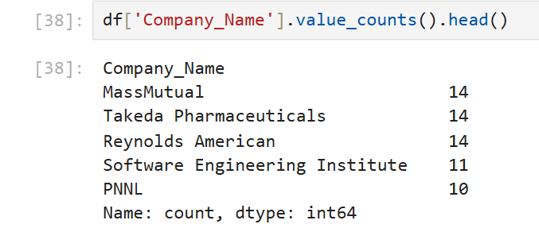
24.Verification of Company Data
This step verifies the company name column and displays sample job counts.

Slide 24
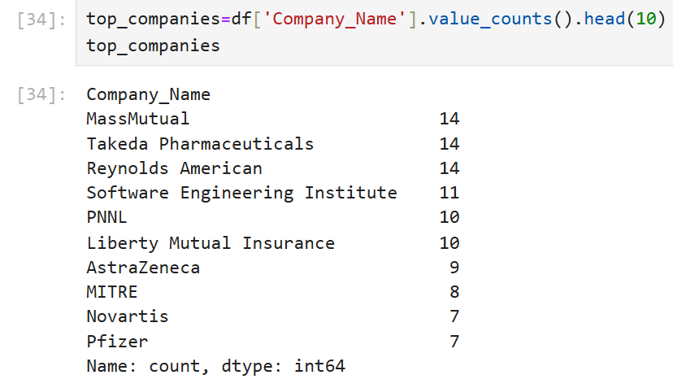
25.Top Companies by Job Openings
This analysis identifies companies with the highest number of job openings in the dataset.

Slide 25
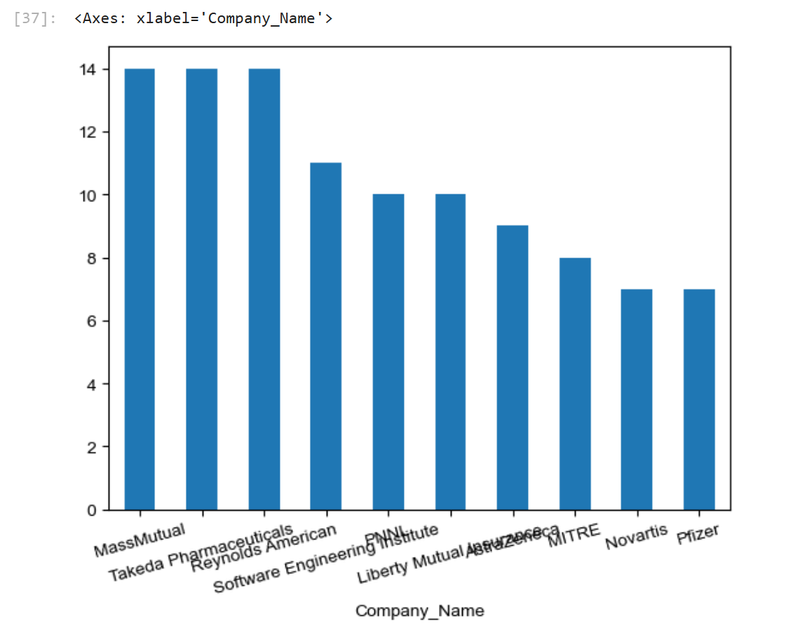
26.Top 10 Companies with Highest Job Openings
This bar chart shows the top 10 companies with the highest number of job openings in the dataset.
It highlights organizations that actively recruit data science professionals.
These companies provide strong career opportunities and stable employment prospects.

Slide 26
27.Insights from Company-wise Job Analysis
A few major companies contribute a large portion of job openings, showing their strong market presence.
Top companies invest heavily in data science and analytics roles to improve business performance.
Companies with more openings provide better chances for learning, growth, and promotion.
Well-established companies consistently hire due to stable operations and long-term projects.
Popular companies attract skilled candidates, increasing competition and improving workforce quality.

Slide 27
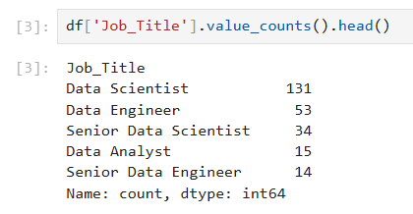
28.Verification of Job Title Data
This step verifies the job title column and displays sample job counts.

Slide 28
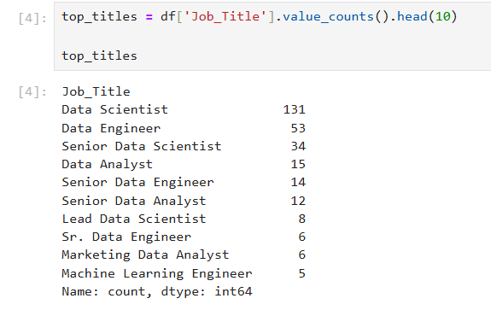
29.Top 10 Job Titles by Job Openings
This analysis identifies the most in-demand job roles in the dataset.

Slide 29

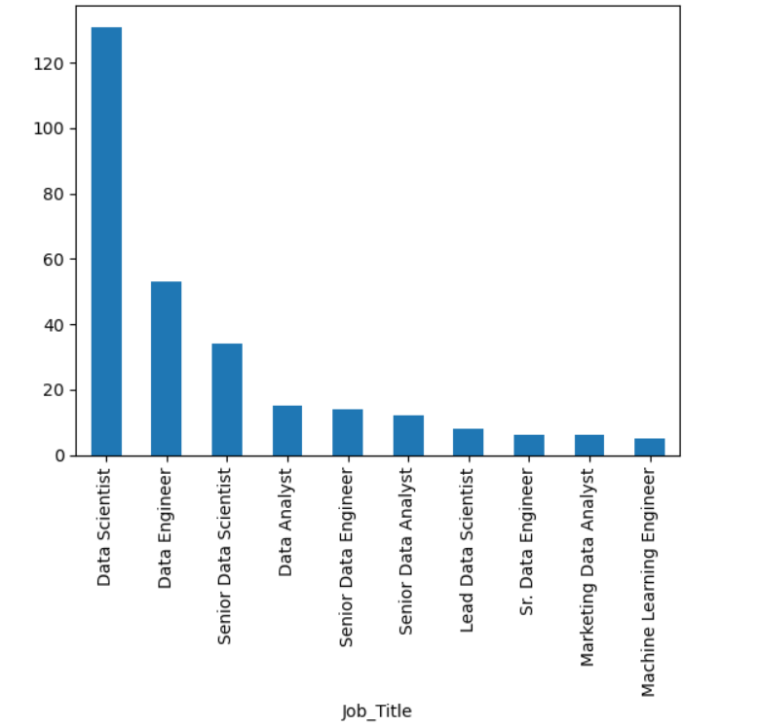
30.Most In-Demand Job Roles
This chart shows job roles with the highest number of openings in the job market.

Slide 30
31.Insights from Job Title Analysis
Data Scientist roles appear most frequently, showing strong industry demand.
Machine Learning and AI-related roles show increasing job opportunities.
Both junior and senior positions are actively recruited.
Specialized roles such as Data Engineer and Analyst are gaining importance.
Multiple job roles indicate diverse career paths in data science.

Slide 31
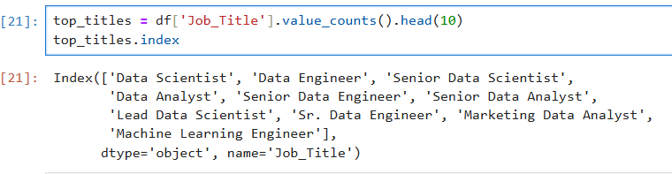
32.Identification of Top Job Titles
This step identifies the most frequently occurring job titles in the dataset.

Slide 32
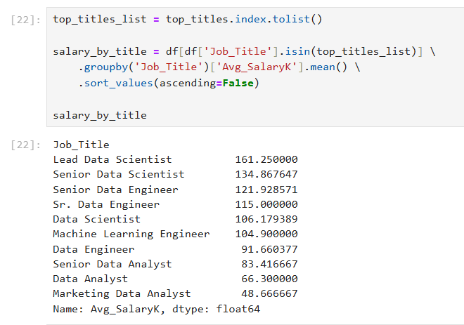
33.Average Salary by Job Title
The average salary for the most common job titles was calculated using groupby and mean functions.

Slide 33

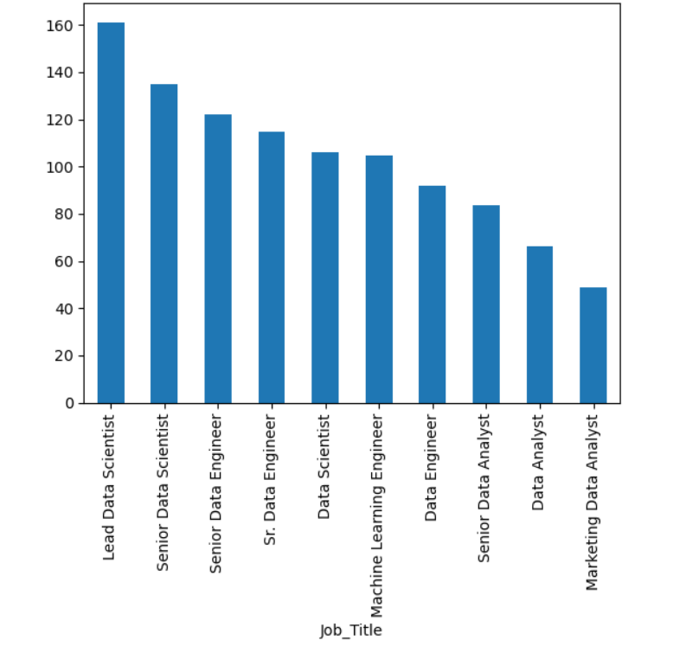
34.Salary Comparison Across Job Titles
This bar chart compares average salaries of the most in-demand job roles.

Slide 34
35.Insights from Job Title Salary Analysis
Senior and specialized job titles receive higher average salaries.
Junior and entry-level positions offer comparatively lower salaries.
Job titles requiring advanced technical skills provide better compensation.
Some popular roles have high demand but moderate salary levels.
Professionals can increase salary by moving to advanced roles.

Slide 35
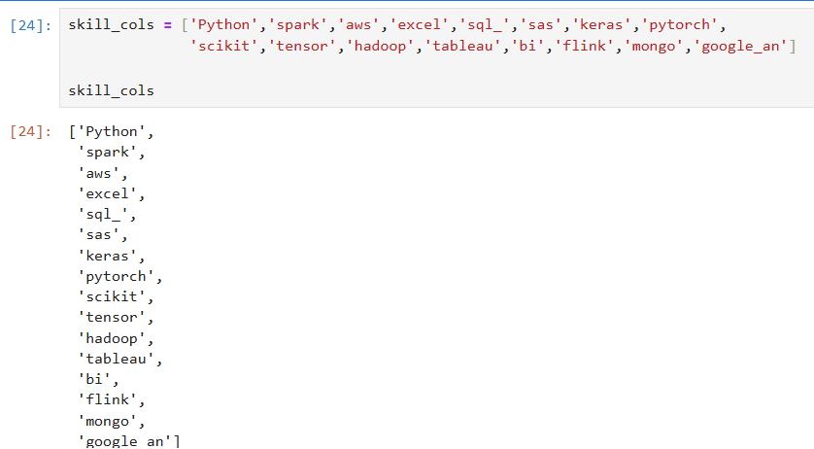
36.Identification of Skill Attributes
This step identifies technical skill columns required for job analysis.

Slide 36
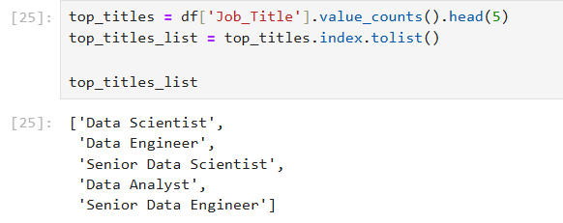
37.Selection of Major Job Roles
The top job titles were selected for skill requirement analysis.

Slide 37
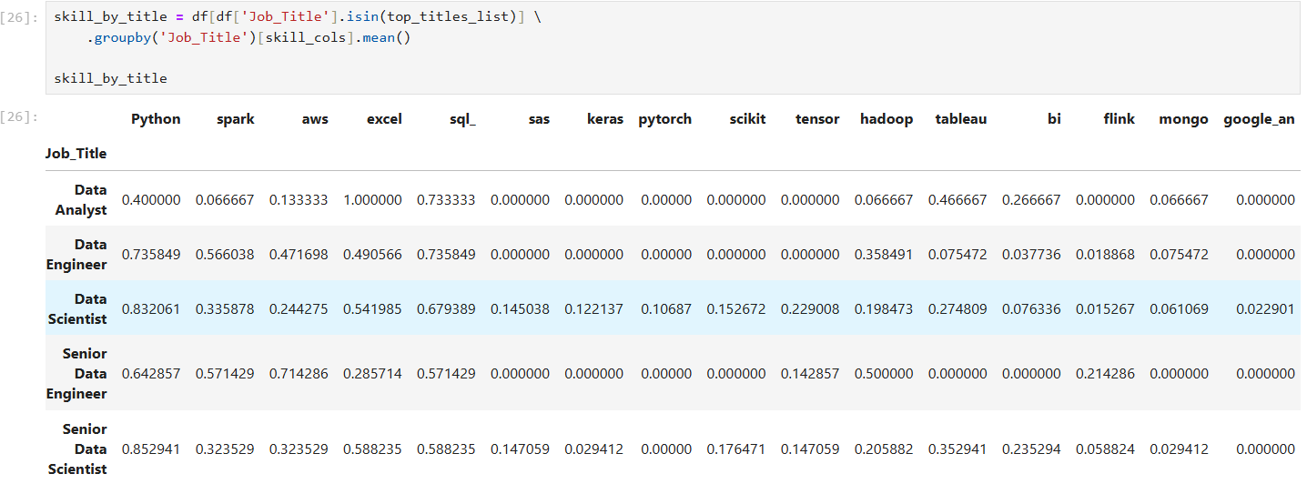
38.Skill Distribution by Job Title
This table shows the percentage of skill requirements for different job roles.

Slide 38
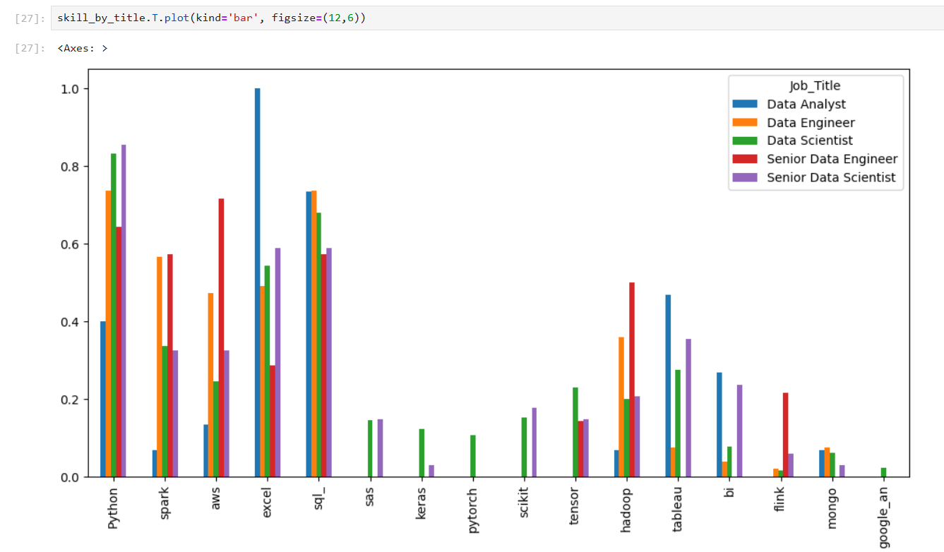
39.Skill Demand Comparison Across Job Roles
The chart compares technical skills required for different job titles.

Slide 39
40.Insights from Skill Analysis
Python appears as the most commonly required skill across job roles.
SQL and Excel are widely required for data handling and analysis.
Machine Learning roles require TensorFlow, PyTorch, and Keras.
Hadoop and Spark are required in data engineering roles.
Tableau and BI tools are important for analyst roles.

Slide 40
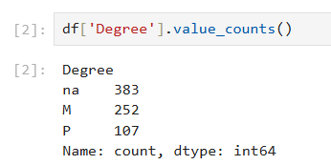
41.Verification of Education Data
This step checks the distribution of educational qualifications in the dataset.

Slide 41
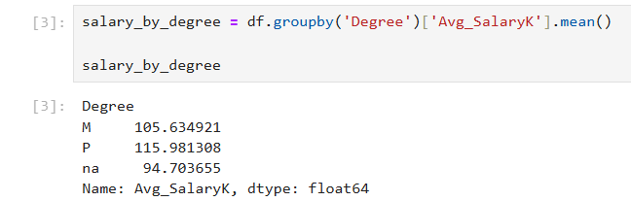
42.Average Salary by Education Level
The average salary was calculated based on educational qualification.
“na” category represents missing education information and is analyzed separately.

Slide 42
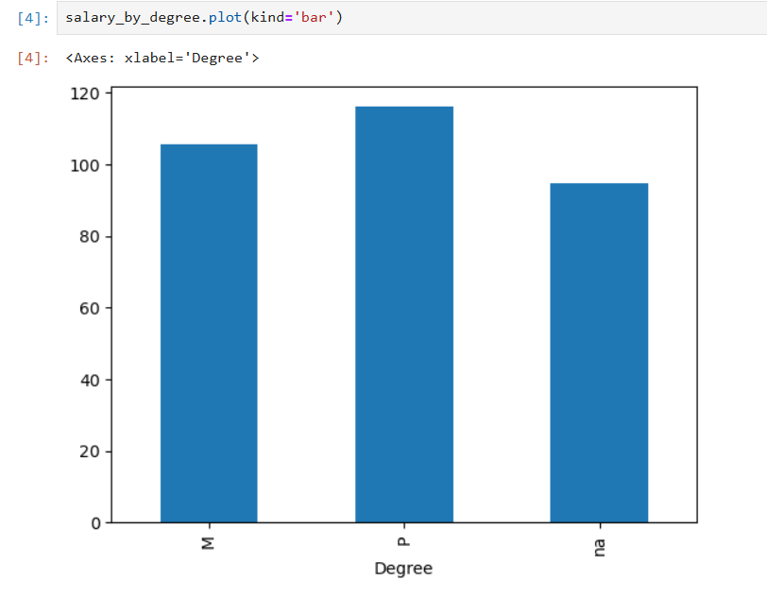
43.Salary Comparison Based on Education
This chart shows how salary varies with education level.

Slide 43
44.Insights from Education vs Salary Analysis
Jobs requiring PhD or Master’s degrees offer higher average salaries.
PhD candidates receive the highest compensation among all categories.
Companies offering degree-based experience credit pay better salaries.
Some roles offer good salary even without advanced degrees.
Higher education increases chances of better roles and long-term growth.

Slide 44
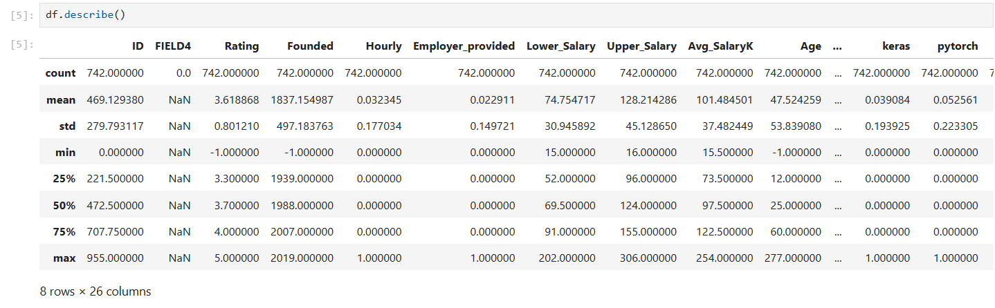
45.Dataset Summary Statistics
This step provides statistical information about numerical features in the dataset.

Slide 45
46.Overall Insights from Complete Analysis
States with strong technology ecosystems offer more jobs and higher salaries.
Candidates with Master’s and PhD degrees receive better compensation.
Python, SQL, Cloud, and ML tools are most demanded across job roles.
IT, Analytics, and Consulting sectors dominate the job market.
Senior-level roles earn higher salaries than junior positions.
Leading organizations create most job opportunities.
New roles like Data Engineer and ML Engineer are increasing.
Location, education, skills, industry, and experience together decide salary.
Consistent hiring shows increasing importance of data-driven systems.
Candidates can move across roles by learning new skills.
Overall,the analysis highlights strong growth and long-term demand for data-related roles.

Slide 46
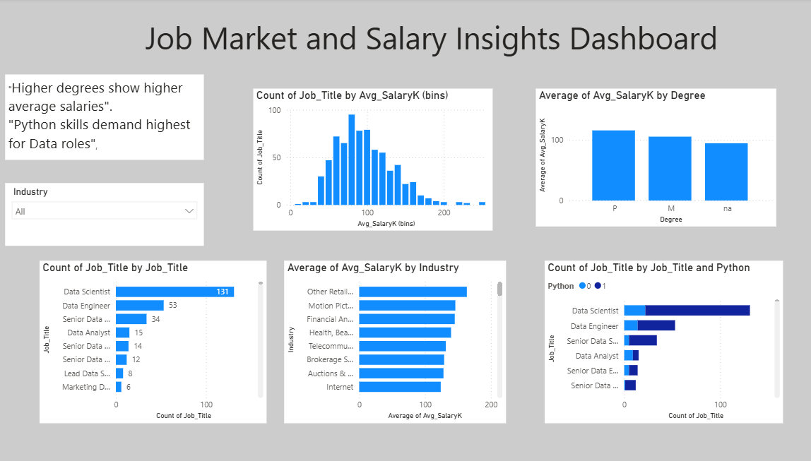
47.Job Market and Salary Insights – Power BI Dashboard

Slide 47
48.Key Insights
Salary Distribution
Most jobs fall in the medium salary range.
Very high-paying jobs are limited.
Entry-level salaries are lower compared to experienced roles.
Salary varies significantly based on role and skills.
Few top positions offer premium packages.
Salary vs Education
Candidates with Master’s and PhD degrees earn higher salaries.
Graduates receive moderate salary packages.
Higher education improves chances of better pay.
Education plays an important role in career growth.
Specialized degrees are more valued.

Slide 48
Average Salary by Industry
IT and Analytics industries offer the highest salaries.
Finance and Healthcare sectors are growing steadily.
Manufacturing and traditional sectors offer lower pay.
Technology-based industries pay more.
High-growth industries attract skilled professionals.
Machine Learning Engineers are in high demand
Data Scientist and Data Analyst roles have maximum openings.
Machine Learning Engineer is in high demand.
Demand for AI-related roles is increasing.
Entry-level roles are fewer than mid-level roles.
Specialized job roles have better opportunities.
Skills Demand Across Job Roles
Python is the most demanded skill.
SQL and AWS are widely required.
Excel is important for analysis roles.
Multiple skills increase employability.
Cloud and ML skills are highly valued.

Slide 49
49.SUGGESTIONS TO THE COMPANY
For Better Hiring
Focus on hiring candidates with strong technical skills like Python, SQL, and AWS.
Offer competitive salaries to attract skilled professionals.
Provide training programs for emerging technologies.
Increase recruitment in high-growth industries.
Support employees for higher education and certifications.
For Business Growth
Invest more in data science and AI teams.
Retain skilled employees with good incentives.
Improve learning and development opportunities.
Encourage multi-skilled workforce.
Use analytics for better decision-making.

Slide 50
50.FUTURE SCOPE
This project can be extended further to provide more detailed and accurate job market analysis in the future.
The dataset can be updated regularly with new job postings to analyze real-time job market trends.
More features such as work experience, remote jobs, company benefits, and job satisfaction can be included for deeper analysis.
Advanced analytics and machine learning models can be applied to predict future salary trends and job demand.
Integration with online job portals can help in collecting live data automatically.
The dashboard can be enhanced with more interactive features and mobile support.
Regional and international job market comparisons can be added for global analysis.
Skill gap analysis can be developed to suggest personalized learning paths for job seekers.
Artificial Intelligence tools can be used to recommend suitable jobs based on candidate profiles.
Company performance and employee retention data can be included for better business insights.
Cloud-based deployment can be implemented for easy access by multiple users.
This project can be scaled for real-time descision-making in recruitment and workforce planning.

Slide 51
51.PROJECT CONCLUSION
This project analyzed the job market trends using real-world job posting data. The dataset was processed and analyzed using SQL, Python, and visualized using Power BI. Various factors such as salary, education, industry, job roles, and skills were studied.
The analysis showed that IT and Analytics industries offer higher salaries compared to traditional sectors. Candidates with higher education qualifications such as Master’s and PhD receive better salary packages. Job roles like Data Scientist and Machine Learning Engineer have the highest demand in the market.
Skill analysis revealed that Python, SQL, and Cloud technologies are the most important skills for data-related jobs. Candidates with multiple technical skills have better career opportunities and higher earning potential.
The Power BI dashboard provided interactive visualizations which helped in understanding job market patterns clearly. It enables employers and job seekers to make data-driven decisions.
Overall, this project successfully identifies key trends, skill requirements, and employment opportunities in the data science job market. The insights and recommendations can help companies improve hiring strategies and help job seekers plan their careers effectively.

Slide 52
Thank You

